Slide 1
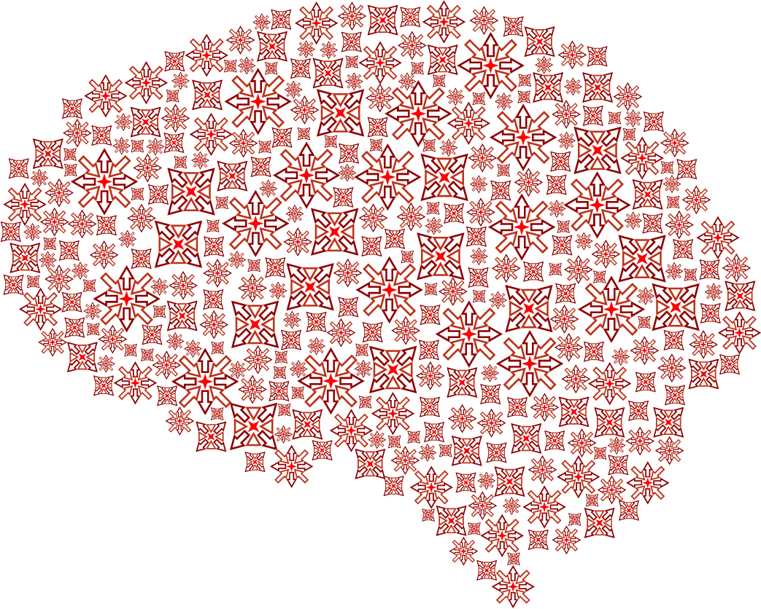
A system with 128 OPMs can outperform a system with 275 SQUIDs
Konstantinos Tsilimparis, Robert Oostenveld

Slide 2


Magnetoencephalography (MEG)
MEG provides extracranial measurements
Magnetic shielded room
Notes:
MEG records the magnetic fields generated by the brain, which are ~1 billion times smaller than the earth magnetic field.
MEG provides extracranial measurements
To keep environmental noise from leaking into our signal, MEG needs to be housed in a Magnetic Shielded Room (MSR)

Slide 3
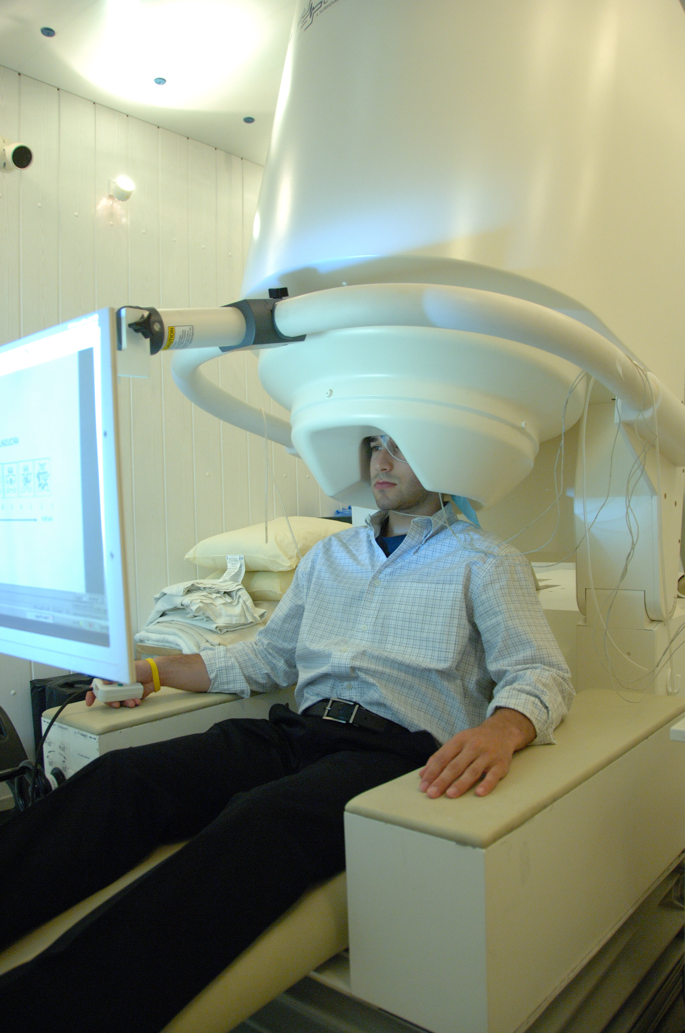
Superconducting Quantum Interference Devices (SQUIDs)
Wikipedia (n.d.)
Notes:
So far the only MEG system that was sensitive enough to pick the brain’s magnetic fields were the SQUIDs.
SQUIDs require cooling close to 0 K which is done with liquid helium. However, liquid helium resources are limited and expensive. For this reason, neuroscientific’s community’s attention has been shifted to a new MEG system:

Slide 4
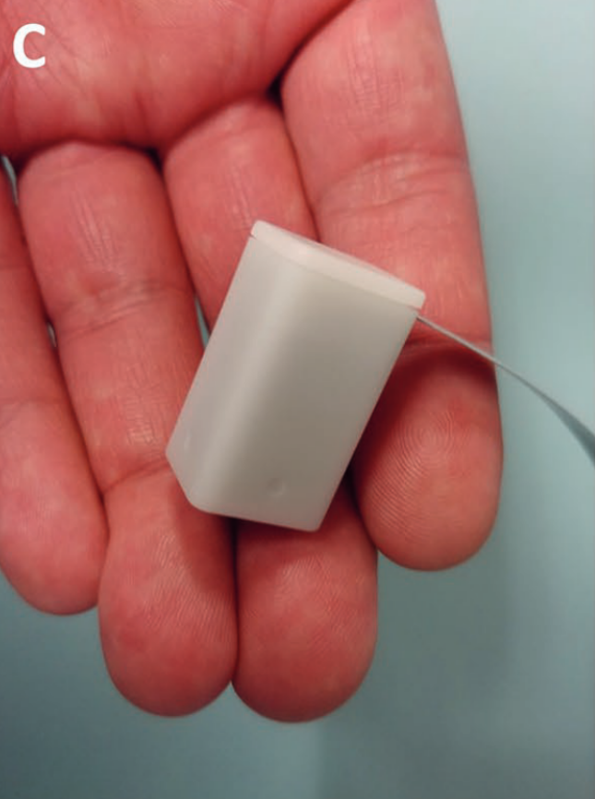
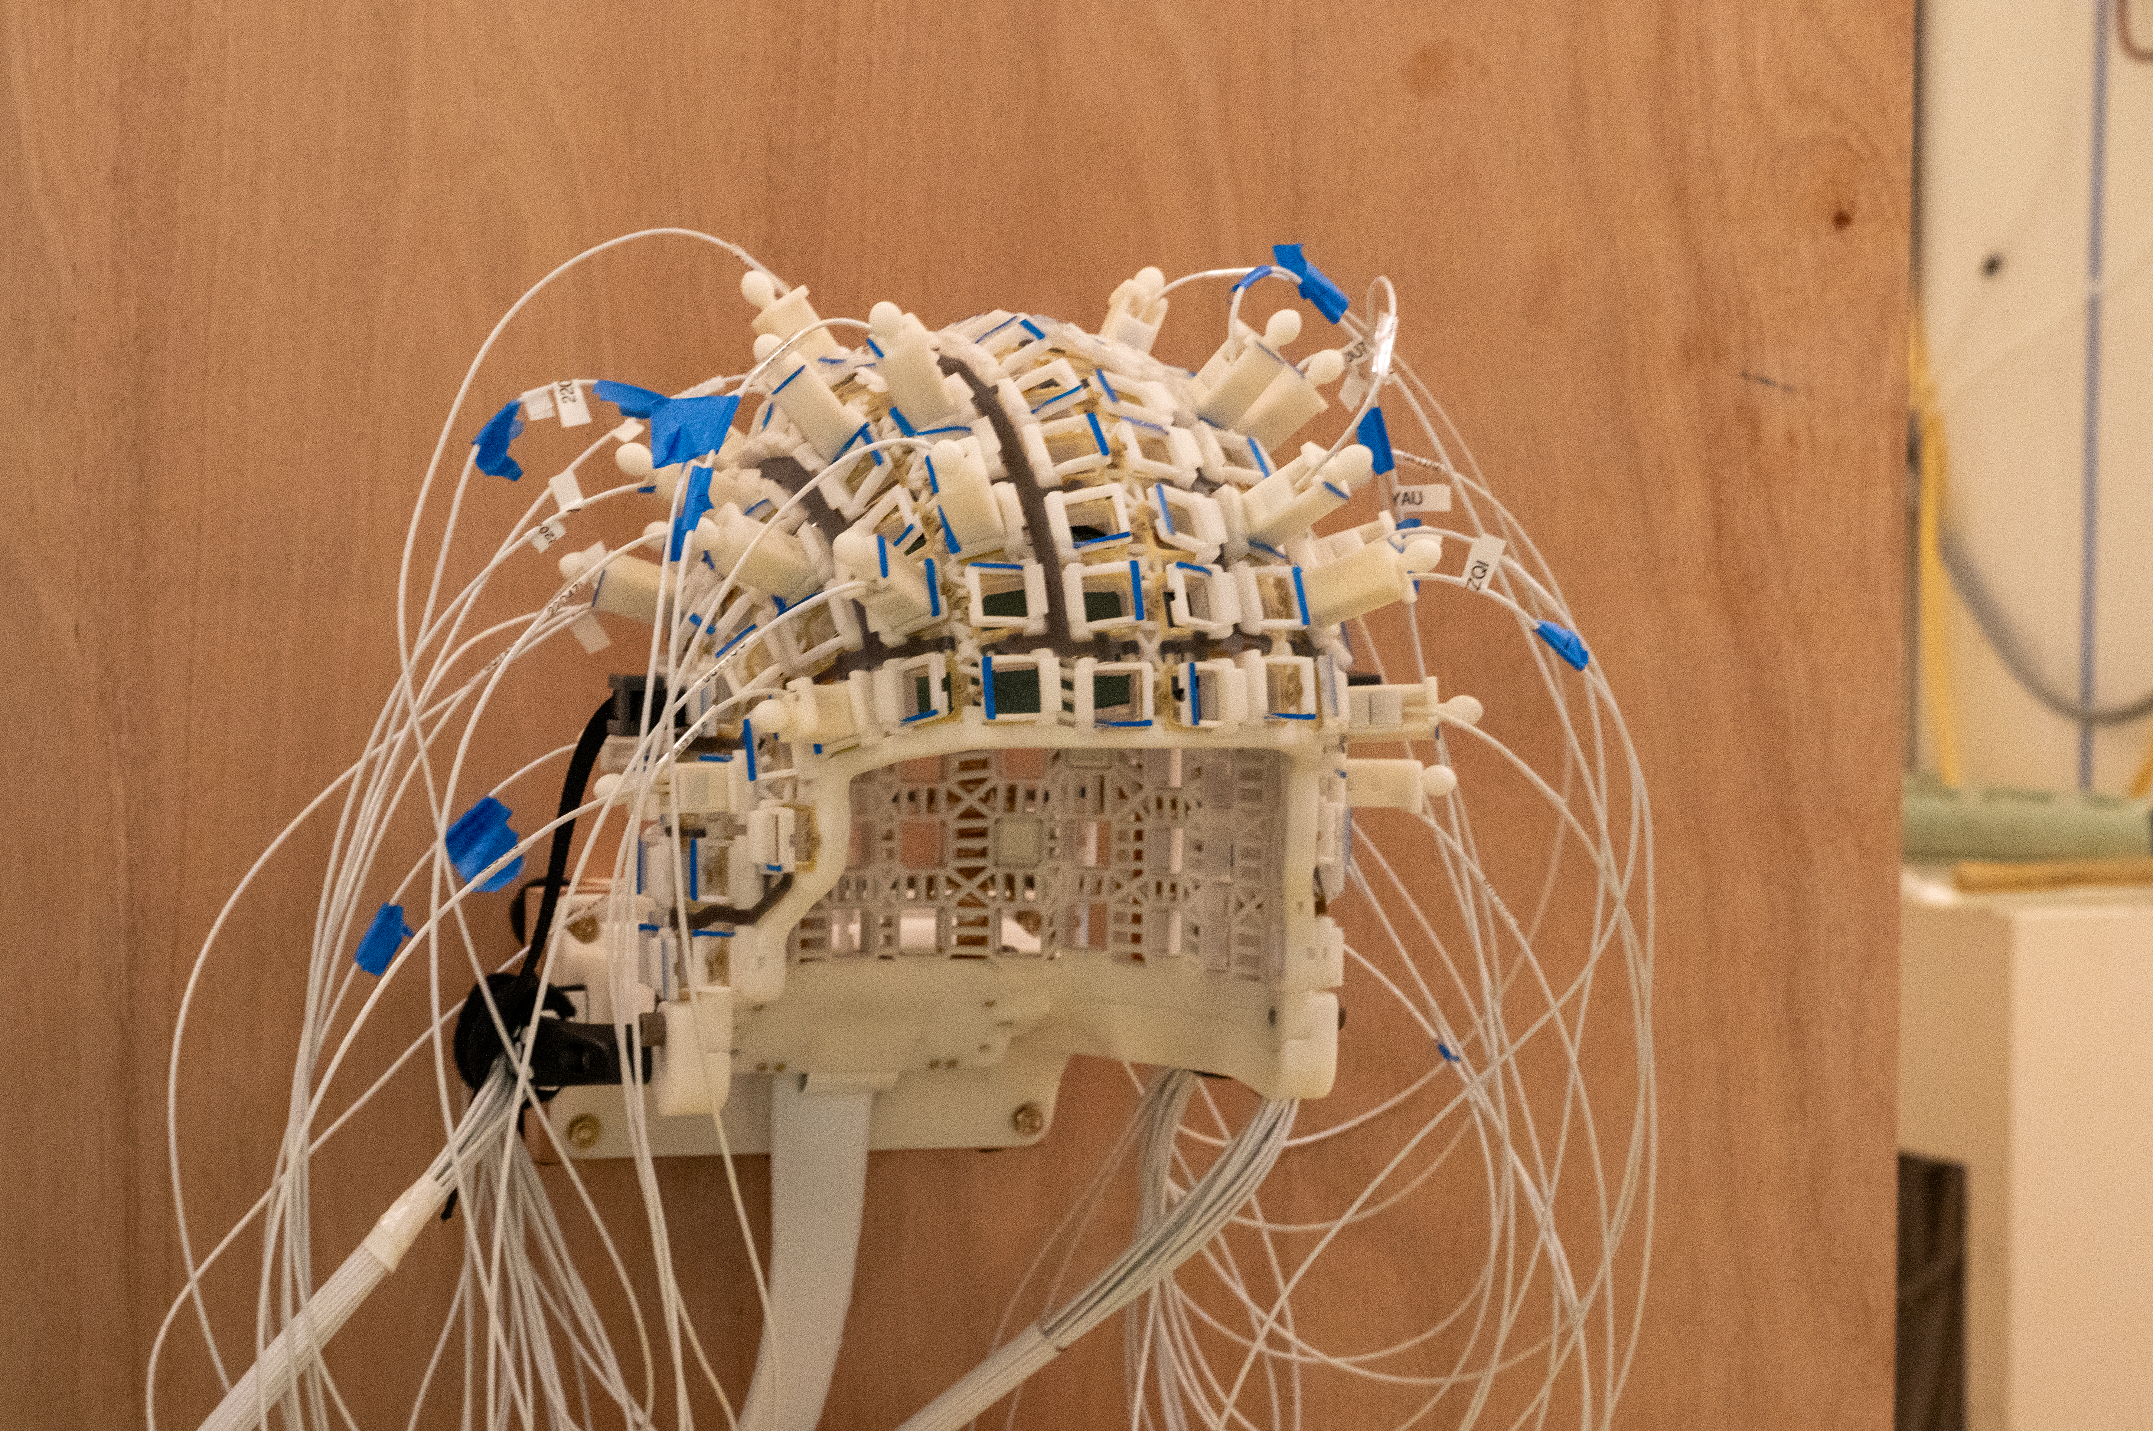
Optically-Pumped Magnetometers (OPMs)
Single OPM sensor
OPM sensors placed in the helmet
Alem et al. (2023)
Notes:
The Optically-Pumped Magnetometers (OPMs).
OPMs come as separate sensors about the size of a sugar cube and can be placed in a helmet to allow whole head coverage.

Slide 5
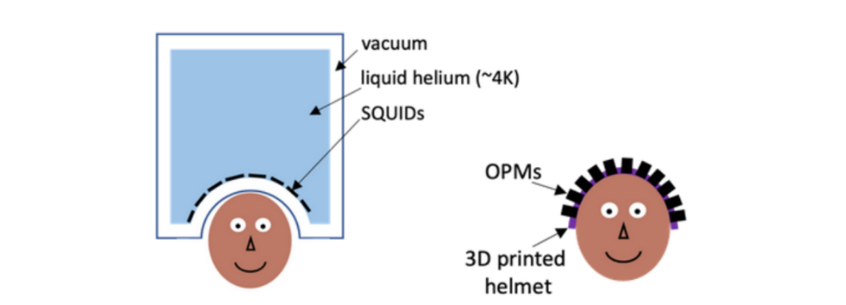
OPMs require no liquid helium
Closer to the scalp
Adjustable 3D helmets
Allow movements
However: Individual OPMs exhibit higher sensor noise compared to individual SQUIDs
SQUIDs
OPMs
NatMEG (n.d.)
Notes:
The main advantage of OPMs is that they do not require liquid helium. As a result, they can be placed closer to the scalp, they can placed in adjustable 3D helmets suitable for adults, children and babies and can allow participant’s movement.
However, individual OPMs exhibit higher sensor noise compared to individual SQUIDs.

Slide 6
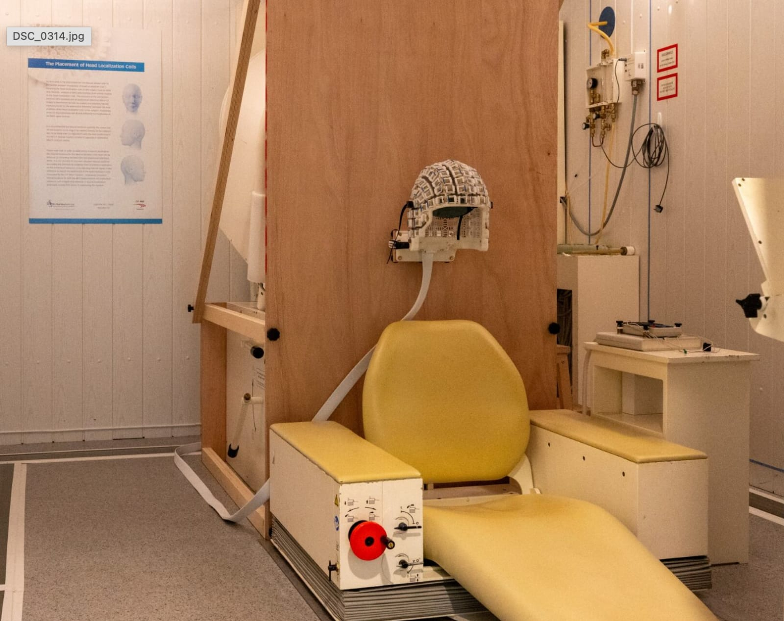
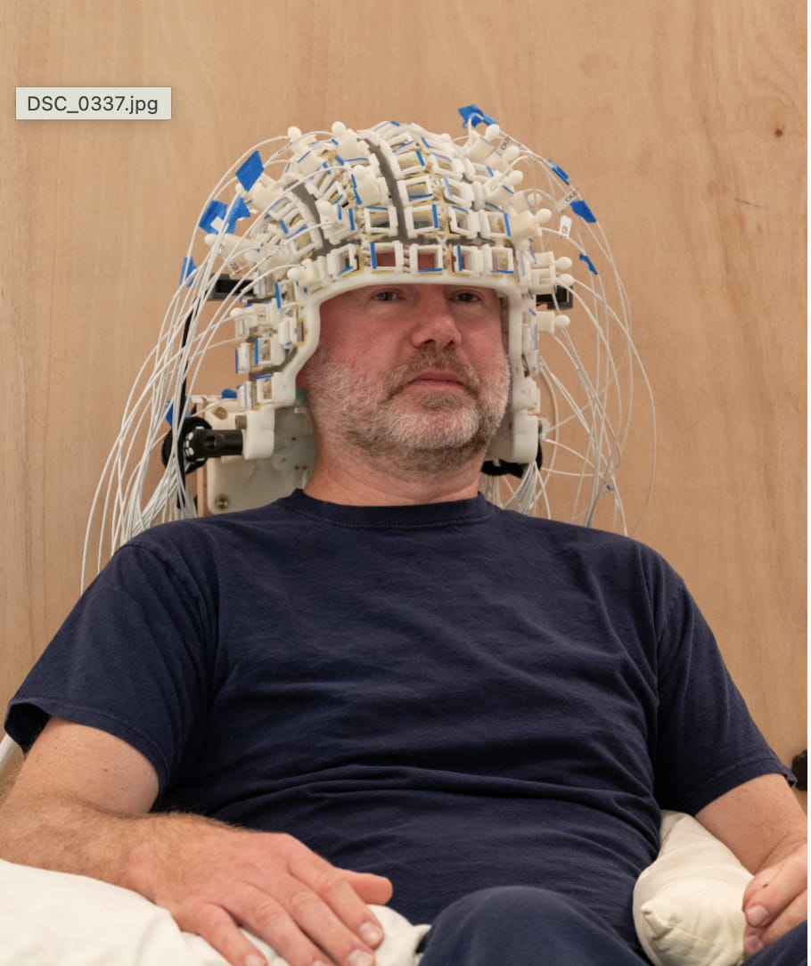
OPMs at the Donders Institute
Notes:
This year at the Donders Institute we acquired an OPM system which comprises of sensors and a helmet.
The OPM system is placed in the same magnetic shielded room as our current CTF SQUID system.
Movements of the helmet come with large artifacts so we decided to mount the helmet on a wooden plate. So, in this research study we do not allow subject head movement.
The helmet has a total of 144 slots and the sensors can easily slide in and out of them until they touch the participant’s head.
At first, we decided to do a small investment by acquiring 32 OPM sensors. In the future we plan to acquire more sensors, but how many more? This study aims to answer that question. More specifically:

Slide 7
Research Question
How many OPMs do we need to outperform the 275-sensor CTF SQUID system?
To answer this question:
Source-level MEG analysis using dipole fitting
Dipole moment and dipole position
Source reconstruction accuracy:
Dipole moment uncertainty (DMU)
Dipole position uncertainty (DPU)
Notes:
We aim to answer the research question: How many OPMs do we need to outperform the 275-sensor CTF SQUID system?
To answer this research question we will perform a source-level MEG analysis using dipole-fitting. Dipole fitting comprises of two parameters: Dipole moment and dipole position.
We compare OPM and SQUID based on the source reconstruction accuracy, which is quantified with the DMU and DPU.

Slide 8
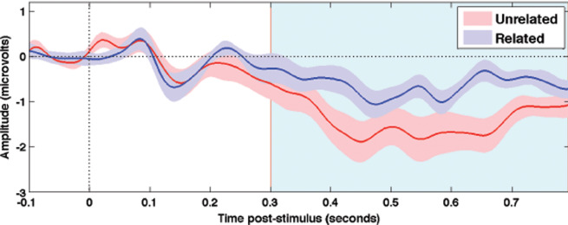
Dipole Moment Uncertainty (DMU)
Accuracy of neural activity strength.
Example: N400 experiment
N400
Cruse et al. (2014)
Notes:
DMU quantifies how accurately we estimate the neural activity strength. DMU is important for cognitive scientists since they aim to design experiments that manipulate this strength of the neural activity with different experimental conditions.
An example is the N400 experiment that relates to the semantic processing. In this graph the DMU is proportional to the shaded areas. The thinner the shaded areas, the lower the MDU and the better we can differentiate the two conditions
That means that an MEG system with low DMU increases statistical sensitivity (= statistical power), which allows to design experiments with less trials and/or add more conditions.

Slide 9
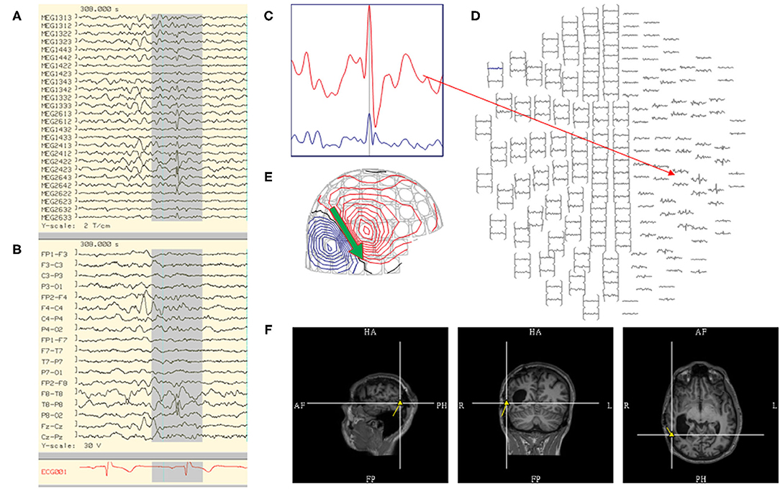
Dipole Position Uncertainty (DPU)
Accuracy of neural activity position.
Example: Epilepsy
Laohathai et al. (2021)
Notes:
DPU quantifies how accurately we estimate the neural activity position.
DPU is important for clinicians working with epileptic patients. For example, a MEG system with low DPU allows to localise with greater accuracy the brain area causing the seizures.

Slide 10
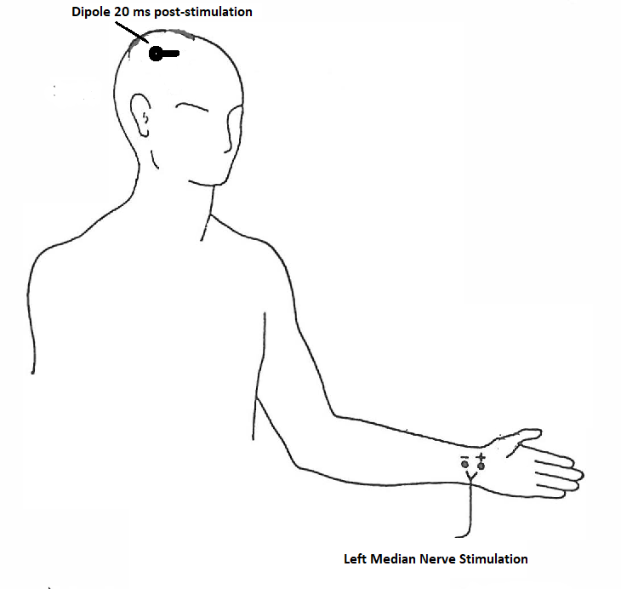
Experiment and simulations
Somatosensory experiment
One participant
OPMs: 32 sensors, 144 slots
SQUIDs: 275 sensors
Simulation of somatosensory activity
Simulate a dipole at the right S1 area
Whole brain simulations
Colin27 average brain
Jamshidi Fard et al (1998)
Notes:
Our work comprises of an experiment and simulations. We first performed an experiment where we stimulated the left median nerve of one participant. The participant performed the same task in the OPM and the SQUID system.
We expect the brain response can be localised with a dipole 20 ms post-stimulation at the right Primary Somatosensory area or S1 area.
Our OPM helmet has 144 slots but we have only 32 sensors. So, to perform a measurement for each slot, we had to repeat the experiment while keeping the participants head fixed.
To validate the results from the experiment, we also performed a simulation where we simulated a dipole at the right S1 area as localised from our experiment.
To extend our comparison to the rest of the brain, we did whole brain simulations where we modelled a dipole for every location on the brain surface. For our whole brain simulations we used the colin27 average brain.

Slide 11
Source reconstruction accuracy
Number of sensors
Spatial resolution of the MEG system
Signal-to-noise ratio
Spatial resolution kept constant
Spatial resolution increases
OPM better | OPM worse
Closer to the scalp Higher signal amplitude | Higher sensor noise
Notes:
source reconstruction accuracy is expected to depend on number of sensors, spatial resolution of the MEG system and signal-to-noise ratio.
Number of sensors and spatial resolution are two interconnected parameters. As we increase the number of sensors we place them in different locations on the scalp thus increasing the spatial resolution.
In our simulations we can manipulate the spatial resolution in a way that is not possible in real recordings. First we keep the spatial resolution constant by placing sensors virtually on top of each other. Then, we move on to more realistic scenario, where we increase the spatial resolution by placing sensors on different locations on the scalp. We always distribute the sensors uniformly around the head.
The OPMs are closer to the scalp meaning that they pick higher signal amplitude especially from superficial sources. However, they also have higher sensor noise than the SQUIDs which can outweigh the advantage of placing sensors closer to the scalp especially for deeper sources.
So, the answer to the question of how many OPM sensors we need is not straightforward.
Let’s see what our results are going to reveal.

Slide 12
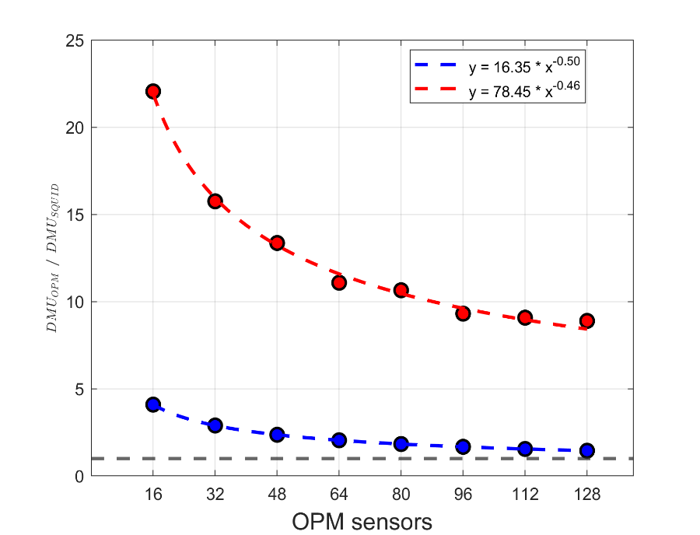
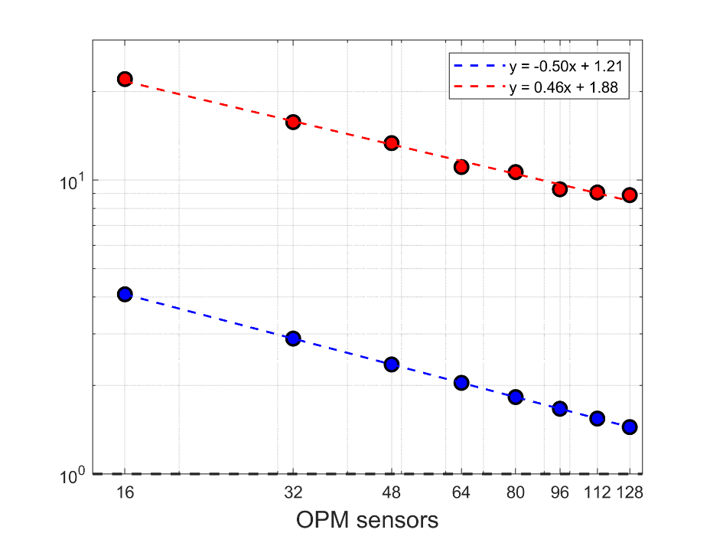



Simulation of a dipole at the right S1 area
Sensor noise OPMs = 3 * sensor noise SQUIDs
Spatial resolution kept constant
20
10
$$DPU_{OPM} / DPU_{SQUID}$$
$$DPU_{OPM} / DPU_{SQUID}$$
$$DMU_{OPM} / DMU_{SQUID}$$
$$DMU_{OPM} / DMU_{SQUID}$$
5
SQUID better
SQUID better
1
1
OPM better
Number of
OPM better
Number of
Notes:
We first GOING TO PRESENT THE RESULTS FROM THE SIMULATION OF a dipole at the right primary somatosensory area, which allows to control the spatial resolution.
In these simulations we set the sensor noise of the OPMs three times higher than the SQUIDs as this is expected from noise levels of the SQUIDs based on our empty room recordings and the reported noise levels of the OPMs in the literature.
We first kept the spatial resolution of the OPMs constant
Along the horizontal axis we have the number of OPM sensors which varies from 16 to 128 in steps of 16. And along the vertical axes we have the ratio of the DMU for the OPMs over the SQUIDs.
Below the horizontal black dashed line, the OPMs perform better and conversely, above the dashed line, SQUIDs perform better.
We see that the more the OPM sensors, the better the performance of the OPMs. However, the improvement in performance becomes smaller and smaller as the number of sensors increase. Mathematically, it can be modelled that DMU decreases by the square root of number of sensors.
In the same graph we plot with the red points the ratio of the DPU for the OPMs over the SQUIDs, we see that DPU also decreases by the square root of number of sensors.
If we plot the previous graph in logarithmic scale, the relation becomes linear

Slide 13
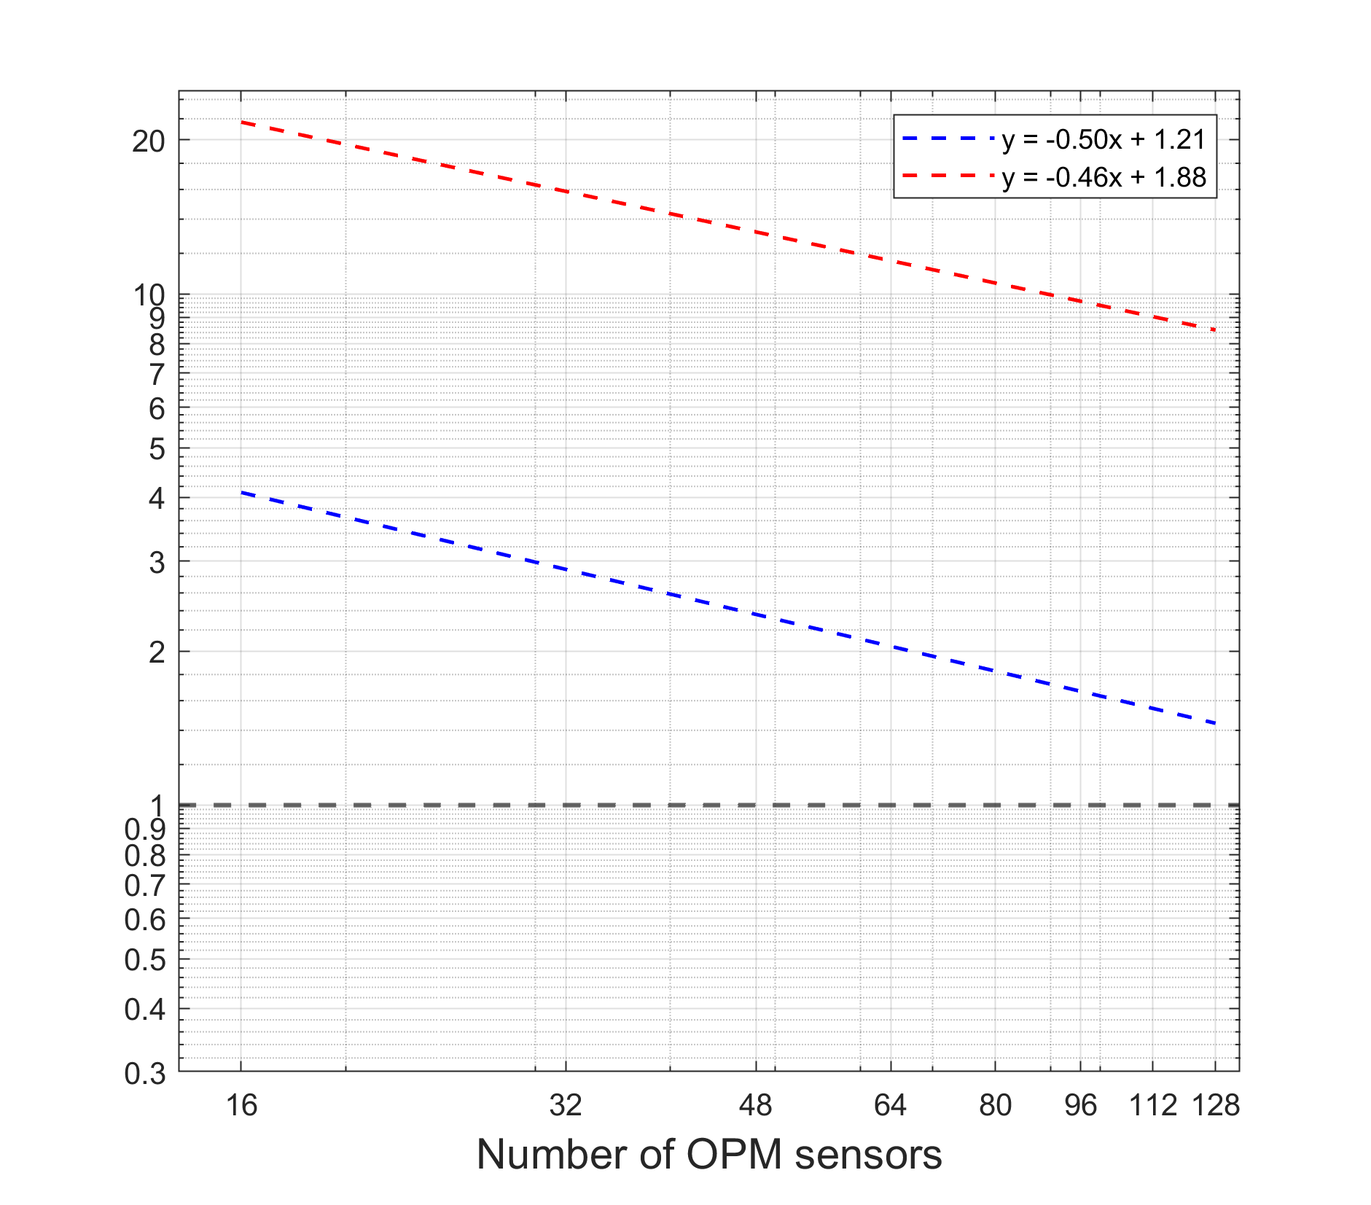


Simulation of a dipole at the right S1 area
Sensor noise OPMs = 3 * sensor noise SQUIDs
Spatial resolution kept constant
$$DMU_{OPM} / DMU_{SQUID}$$
$$DPU_{OPM} / DPU_{SQUID}$$
SQUID better
OPM better
Notes:
This logarithmic graph is the same as in the previous slide where the spatial resolution is kept constant by placing sensors virtually on top of each other.
To test what happens in a more realistic scenario, we perform the same simulation but now we increase the spatial resolution by placing sensors on a different location on the scalp

Slide 14
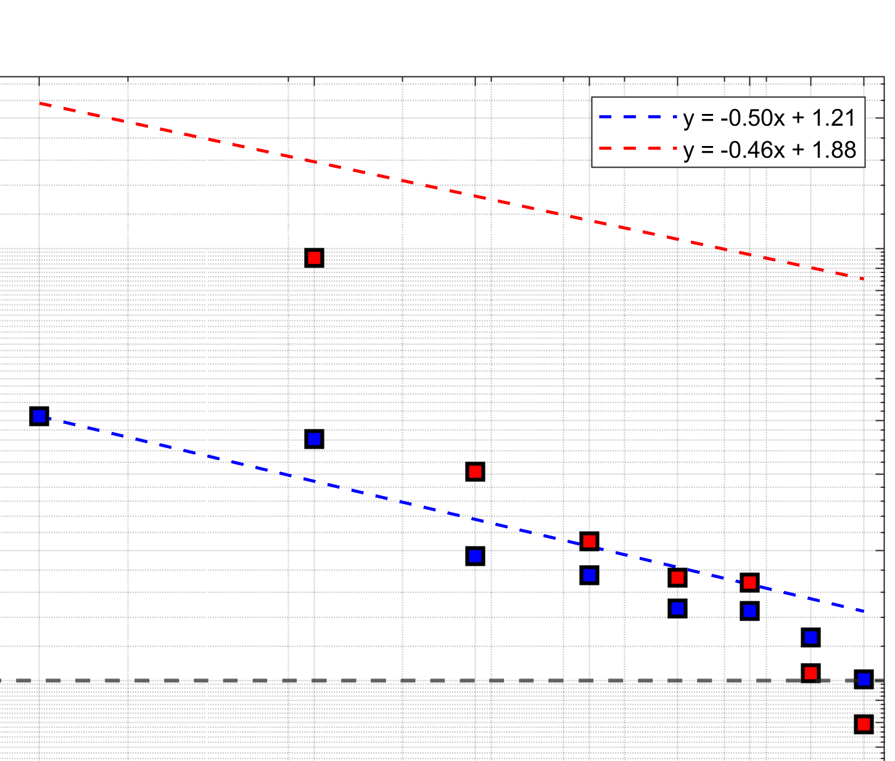
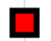
Simulation of a dipole at the right S1 area
Sensor noise OPMs = 3 * sensor noise SQUIDs
Spatial resolution increases
$$DMU_{OPM} / DMU_{SQUID}$$
$$DPU_{OPM} / DPU_{SQUID}$$
SQUID better
SQUID better
OPM better
OPM better
128 OPMs have equal DMU to 275 SQUIDs
112 OPMs have equal DPU to 275 SQUIDs
Notes:
In comparison to the constant spatial resolution, we see that the improvement of DMU and DPU becomes more rapid as the number of OPM sensors increase.
Dipole moment uncertainty improves more rapidly because when we increase the spatial resolution we place sensors closer to each other results in some sensors being closer to the peaks of the dipolar pattern. On the other hand, dipole position uncertainty improves more rapidly because placing sensors closer to each other results in results in capturing better the gradients in the topography which are the areas around the peaks of the dipolar pattern.
DPU improves more rapidly than the DMU, meaning that DPU benefits more from placing sensors closer to each other.
Looking at the data points that cross the horizontal dashed line, we can conclude that a system with 128 OPMs has equal DMU as a system with 275 SQUIDs and a system with 112 OPMs has equal DPU as a system with 275 SQUIDs.
Our last data point which is for 128 OPM sensors and is close the horizontal dashed line meaning that in our simulations around 128 OPM sensors perform equally to 275 SQUID sensors

Slide 15
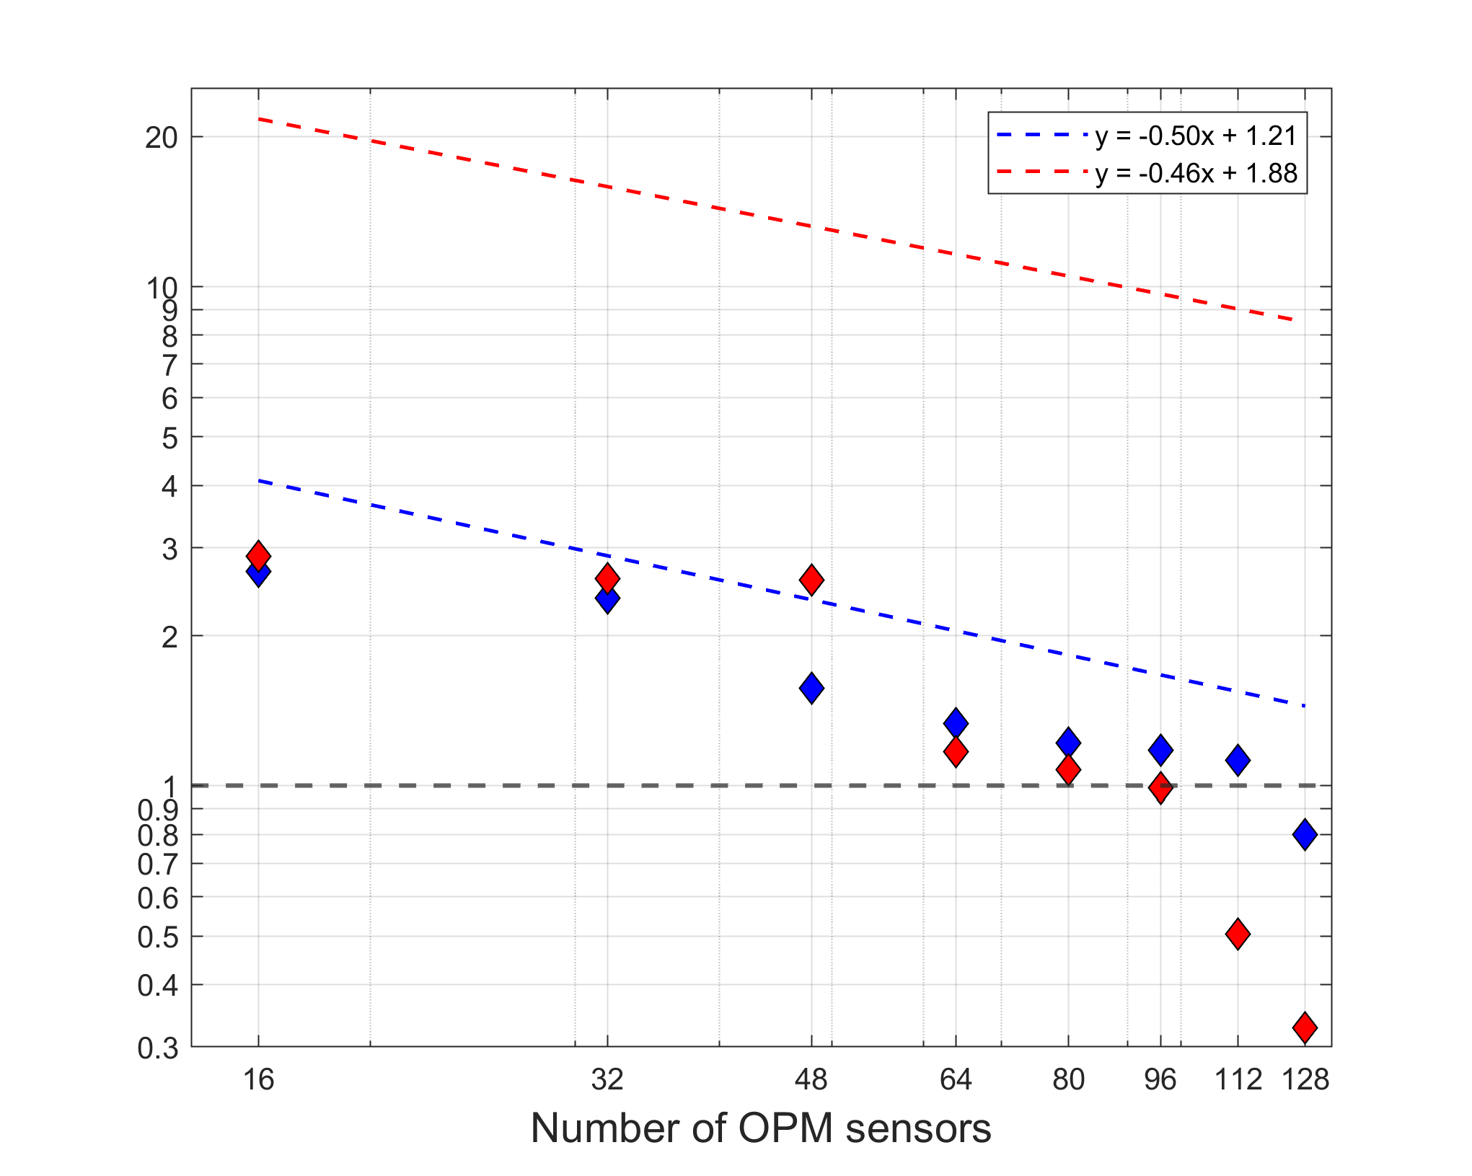


Experiment
OPM & SQUIDs influenced by sensor noise & environmental noise
Spatial resolution increases
$$DMU_{OPM} / DMU_{SQUID}$$
$$DPU_{OPM} / DPU_{SQUID}$$
SQUID better
OPM better
112-128 OPMs have equal DMU to 275 SQUIDs
96 OPMs have equal DPU to 275 SQUIDs
Notes:
In comparison to the simulated data, which were influenced only by sensor noise and allowed for controlling of the spatial resolution, the experimental data are influenced by both sensor and environmental noise and can only have spatial resolution that increases
As in the simulated data, in the experiment we also observe that DPU improves more rapidly than the DMU.
Looking at the data points that cross the horizontal dashed line, we can conclude that a system with 112 to 128 OPMs has equal DMU as a system with 275 SQUIDs and a system with 96 OPMs has equal DPU as a system with 275 SQUIDs.

Slide 16
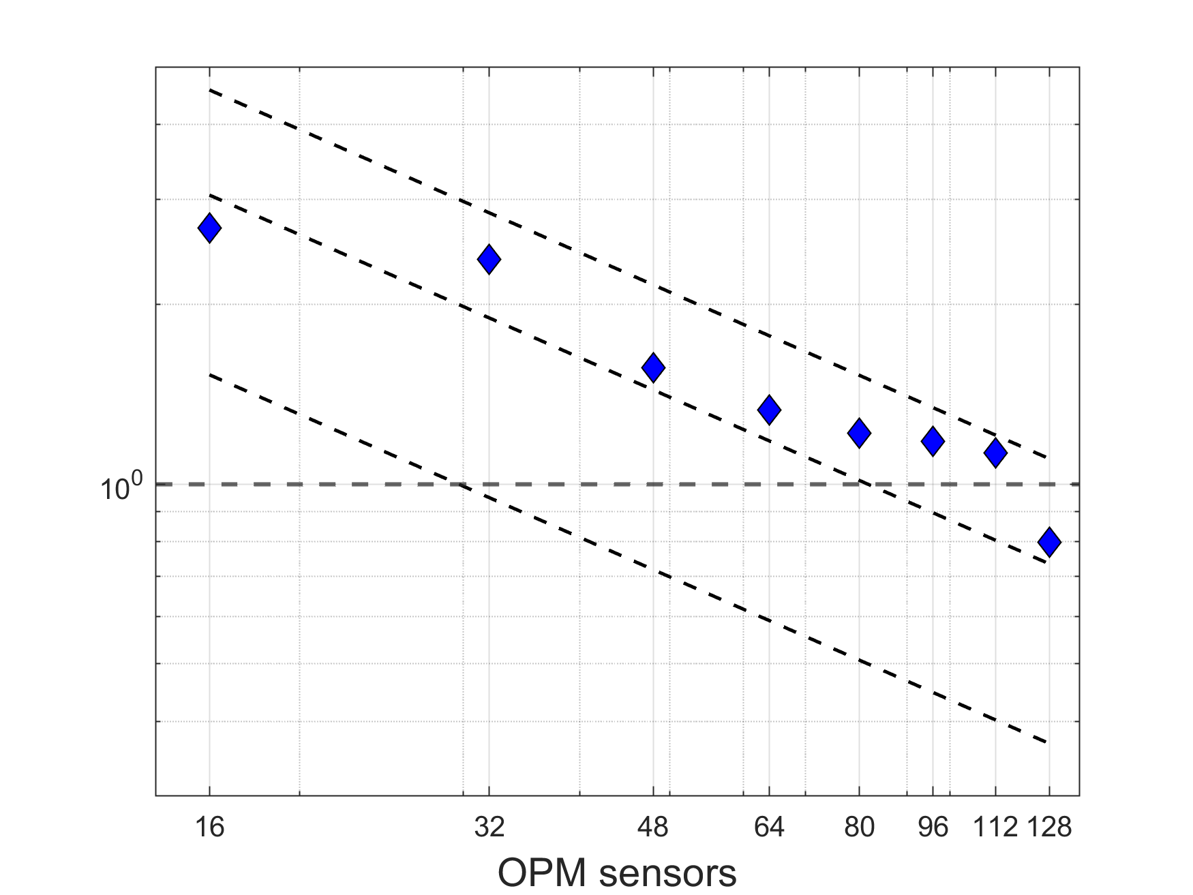



Experimental and simulated data
Spatial resolution increases
5
SQUID better
$$DMU_{OPM} / DMU_{SQUID}$$
1
$$\text{sensor} \text{noise} \text{OPMs}\text{ = 3 ∗ }\text{sensor} \text{noise} \text{SQUIDs}$$
$$\text{sensor} \text{noise} \text{OPMs}\text{ = 2 ∗ }\text{sensor} \text{noise} \text{SQUIDs}$$
OPM better
0.3
$$\text{sensor} \text{noise} \text{OPMs}\text{ = 1 ∗ }\text{sensor} \text{noise} \text{SQUIDs}$$
Number of
Experiment: sensor noise OPMs = 2-3 * sensor noise SQUIDs
DMU benefits from lowering the sensor noise
Notes:
To estimate the noise in the experiment, we compared the ratio of DMU for the experimental data and the simulated data.
The experimental blue data points fall between the two dashed lines where the sensor noise of the OPM sensors was set to be 2 and 3 times higher than the SQUIDs
Hence in the experiment the sensor noise of the OPMs appear to be two to three times higher than the sensor noise of SQUIDs, which is lower than we expected.
Here it is also important to note that the DMU benefit from lowering the sensor noise. For example decreasing the OPM sensor noise from 3 to 1 time that of SQUIDs would decrease the number of OPM sensors needed from approximately 128 to only approximately 32.

Slide 17
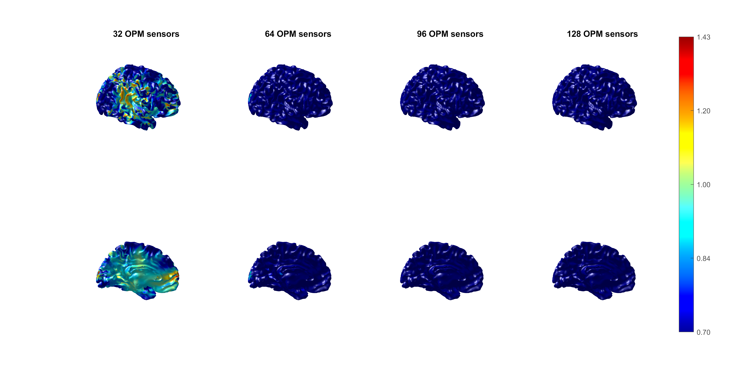
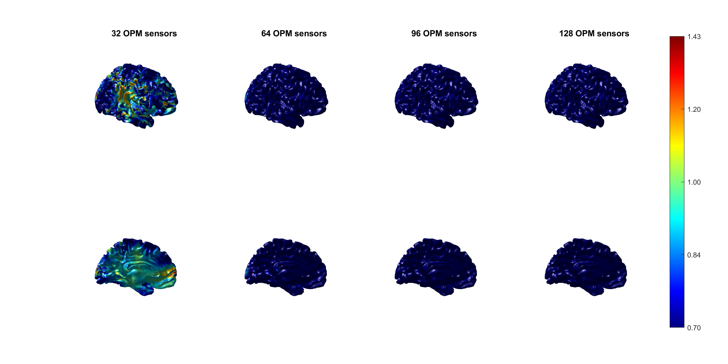
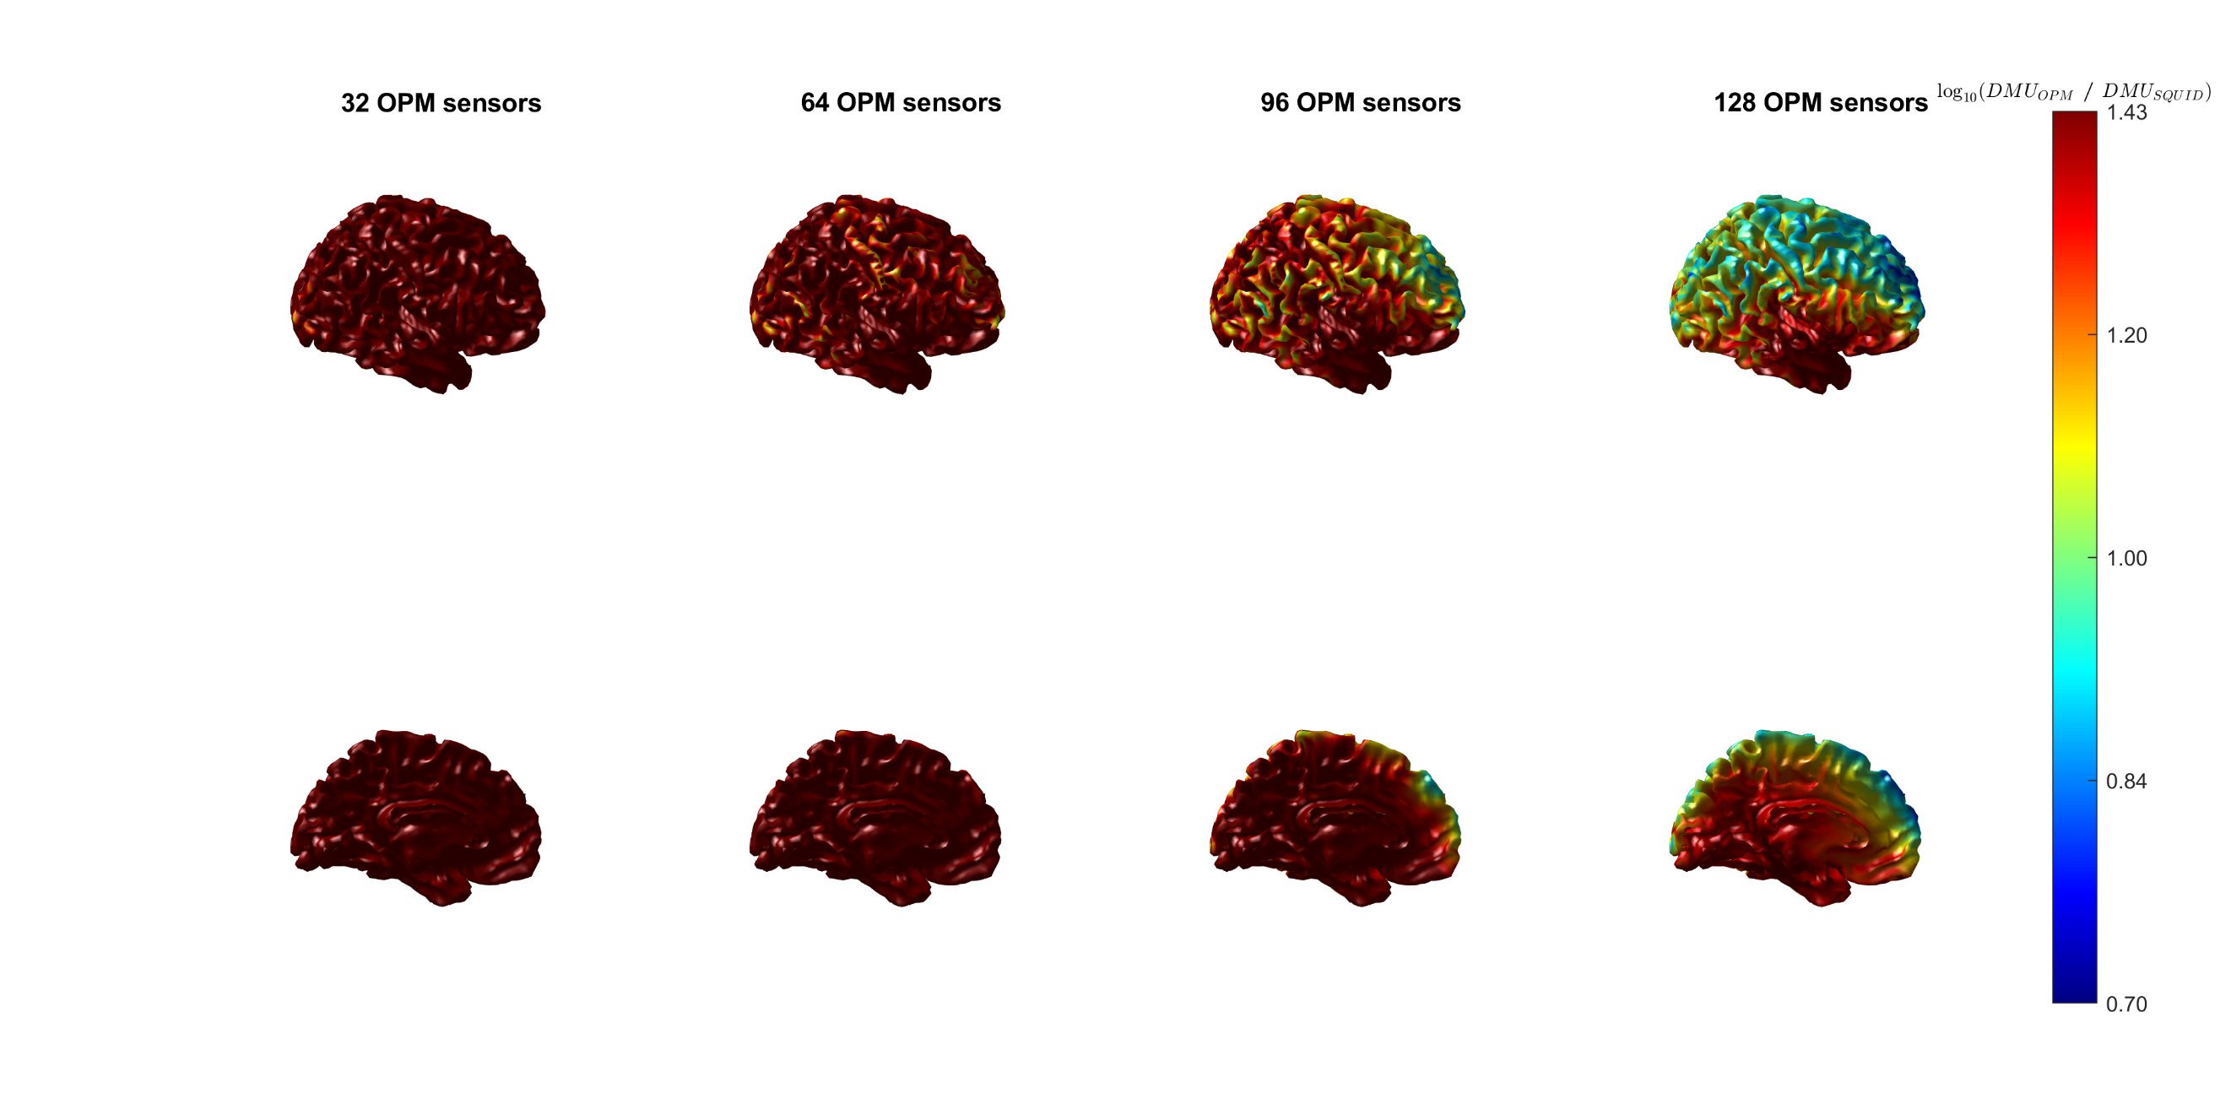

Dipole moment uncertainty - Whole brain simulations
Sensor noise OPMs = 1 * sensor noise SQUIDs
Spatial resolution increases
SQUID better
OPM better
Around 32 OPMs have equal DMU to 275 SQUIDs
For superficial and deep sources
Notes:
Next we performed whole-brain simulations to generalize our results to the rest of the brain.
First we selected the sensor noise of the OPMs equal to the sensor noise of the SQUIDs AND WE INCREASED THE SPATIAL RESOLUTION.
The colorbar represents the ratio of the DMU for OPM over SQUID. Blue color means that the OPMs perform better, red color means that the SQUIDs perform better and Green color means that the OPMs and SQUIDs perform equally.
We varied the number of OPM sensors from 32 to 64 to 96 and 128. The top row shows better the superficial brain areas while the bottom row shows better the deeper brain areas.
We can see that the green color starts to appear at only 32 OPM sensors for both superficial and deep sources, meaning that 32 OPMs can perform equally to 275 SQUIDs for both superficial and deep sources
However, as I said individual OPMs exhibiti higher sensor noise than the SQUIDs. So in reality the figures would look more like these:

Slide 18




Dipole moment uncertainty - Whole brain simulations
Sensor noise OPMs = 3 * sensor noise SQUIDs
Spatial resolution increases
SQUID better
OPM better
Around 128 OPMs have equal DMU to 275 SQUIDs
For superficial sources, but not for deep sources
Notes:
We selected the sensor noise of the OPMs 3 times higher than the sensor noise of the SQUIDs as it is expected.
Green color starts to appear at 128 OPMs mostly on superficial brain areas but not for deeper brain areas and the temporal lobe. In the temporal lobe, OPMs also do not perform well, likely due to the head and brain geometry which prevents us from placing sensors close to the temporal lobe, even if we place them on the scalp.
So, we can conclude that a system with 128 OPMs has equal DMU to a system with 275 SQUIDs for superficial brain sources but not for deep sources.

Slide 19
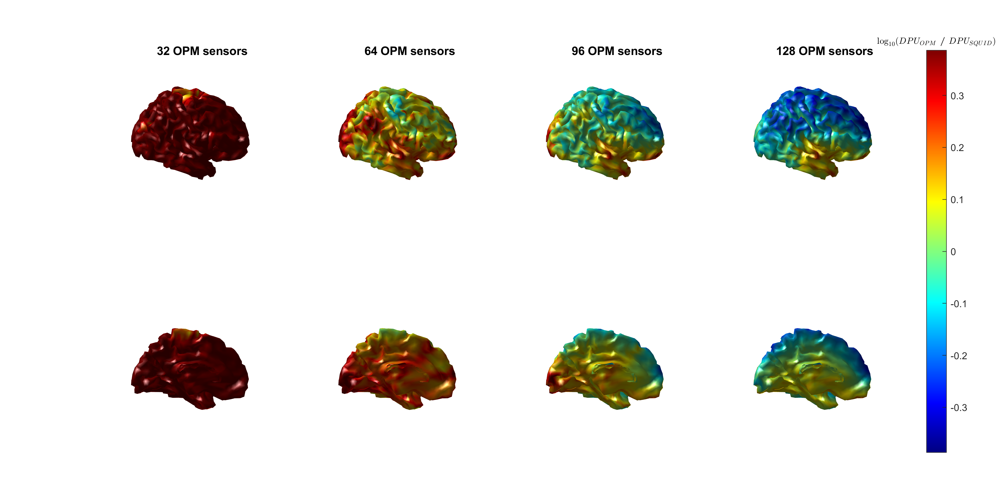

Dipole position uncertainty - Whole brain simulations
Sensor noise OPMs = 3 * sensor noise SQUIDs
Spatial resolution increases
SQUID better
OPM better
Around 96 OPMs have equal DPU to 275 SQUIDs
For superficial sources, but not for deep sources
Notes:
For the dipole position uncertainty we also performed whole brain simulations and we set the sensor noise of the OPMs 3 times higher than the SQUIDs.
Green color starts to appear for 96 OPMs mostly on superficial brain areas but not for deeper areas and the temporal lobe. So, we can conclude that a system with 96 OPMs has equal DPU to a system with 275 SQUIDs for superficial brain sources but not for deep sources.

Slide 20
Source reconstruction accuracy: dipole moment vs dipole position
Estimation of | Benefits from | Recommendation | Relevant research
Dipole moment | Sensors on the peaks of the dipolar pattern Lower sensor noise | High number of sensors to average out sensor noise OPM systems with low sensor noise | Cognitive scientists
Dipole position | Sensors closer to each other | High density OPM systems | Clinicians (epilepsy)
Hillebrand et al. (2023); Cruse et al. (2014)
Notes:
The optimal number of OPM sensors required can vary whether we investigate the dipole moment or dipole position
Our study showed that the estimation of the dipole moment benefits from placing sensors on the peaks of the dipolar pattern and lowering the sensor noise. Hence, getting high number of sensors to average out the sensor noise and the design of OPM arrays with low sensor noise will facilitate cognitive scientists.
On the other hand the estimation of the dipole position benefits from placing sensors closer to each other. Hence the design of high density OPM systems will facilitate the clinicians working on epilepsy.

Slide 21
OPMs do not perform well in deeper brain areas
Estimation of | Benefits from | Recommendation | Relevant research
Dipole moment Dipole position | Lower sensor noise | OPM systems with low sensor noise | Hippocampal epileptiform activity Subcortical structures in balance and gait
Hillebrand et al. (2023); Nonnekes et al. (2015)
Notes:
OPMs do not perform well in deeper brain areas
Our study showed that for deeper brain areas the estimation of the dipole position and dipole moment benefits from lowering the sensor noise. So the design of OPM systems with low sensor noise would facilitate research such as detection of hippocampal epileptiform activity that is the goal of our colleagues in the Amsterdam umc or understanding how the subcortical structures support balance and gait as investigated by colleagues in the Radboud umc.

Slide 22
Conclusion
Based on | Compared to 275 SQUIDs | Brain area
Simulations | OPMs are set 3x noisier 128 OPMs have equal dipole moment uncertainty 112 OPMs have equal dipole position uncertainty | Superficial sources Not deep sources
Experiment | OPMs are estimated 2-3x noisier 112-128 OPMs have equal dipole moment uncertainty 96 OPMs have equal dipole position uncertainty | Source at the right S1 area (superficial source)
Notes:
In conclusion based on our simulations,
-we set the noise of OPMs 3 times higher than the SQUIDs,
-128 OPMs have equal DMU to 275 SQUIDs and
-112 OPMs have equal DPU to 275 SQUIDs
-These results apply to superficial sources but not for deep sources.
based on our experiment,
-we estimated the noise of OPMs 2 to 3 times higher than the SQUIDs,
-112 to 128 OPMs have equal DMU to 275 SQUIDs and
-96 OPMs have equal DPU to 275 SQUIDs
-These results apply to superficial sources but not for deep sources.

Slide 23
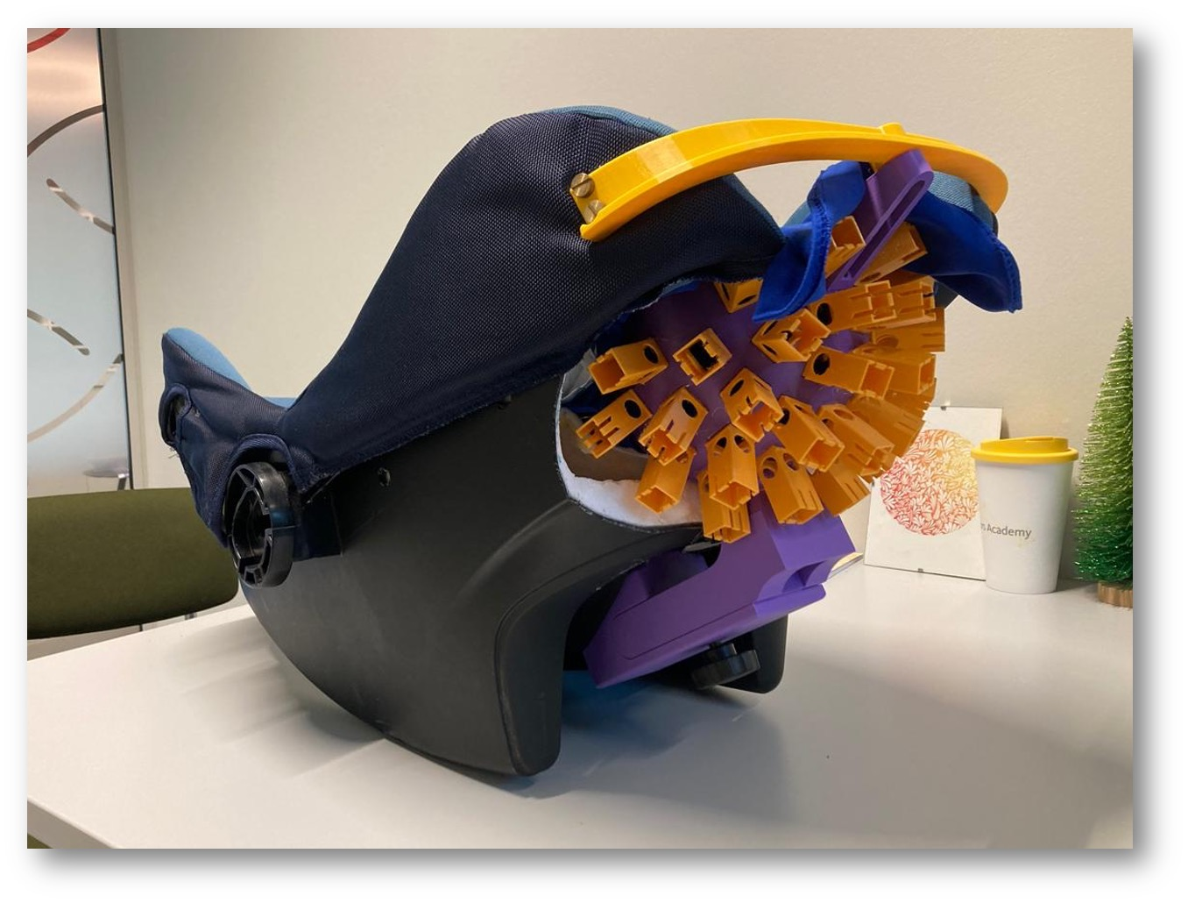
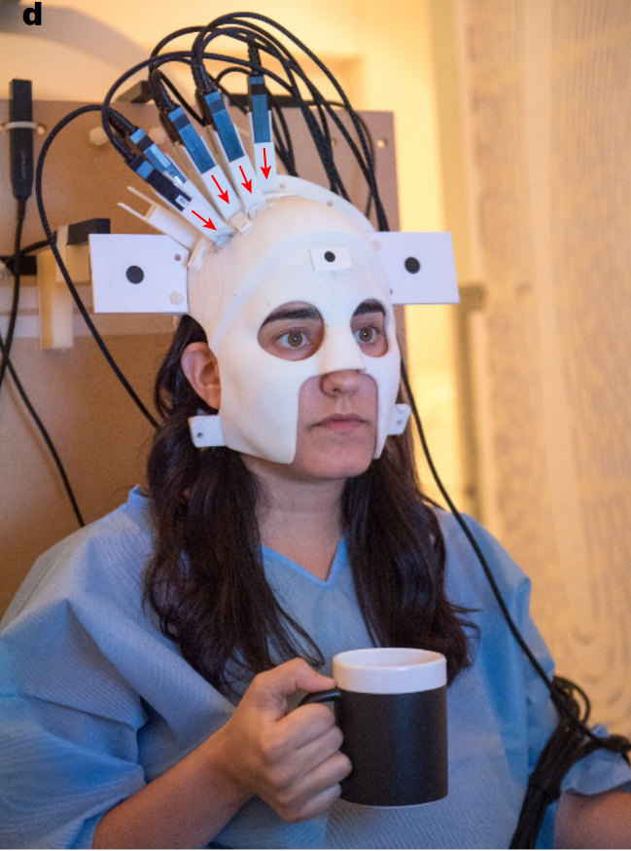
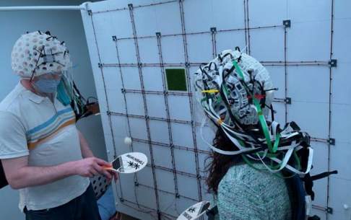
OPMs as the next generation of MEG at the Donders Institute
A system with ~128 OPMs can outperform the 275-sensor CTF SQUID system
OPMs less noisy than expected but remain noisy for deeper structures
OPMs sensors can operate in our magnetic shielded room without additional shielding
OPM system will allow for new experiments not possible with the SQUID system
Boto et al. (2018); Holmes et al. (2021)
Notes:
Our research helped us to better understand the OPMs but also guide our decision about the OPMs as the next generation of MEG at the Donders Institute.
We showed that around 128 OPMs can outperform the 275-sensor CTF SQUD system. Our OPMs are less noisy than we expected but remain noisy for deeper structures. Therefore, imaging of deeper brain structures is still challenging.
With our OPM helmet mounted on a wooden plate, our OPM sensors can operate in our magnetic shielded room without additional shielding such as nulling coils for static or dynamic noise cancellation.
Even though in this thesis we compare the OPM and SQUID systems, we should also consider that the OPM system will allow for new experiments that are not possible with the SQUID system. So instead of the OPMs replacing the SQUIDs we can use both systems . For example:
We can use the OPMs to image the brain of individuals who have smaller head sizes and might have difficulty sitting still. For example Marleyne and Robert have already started a project on imaging the brain of babies
We can use the OPMs to experiments that involve movement, for example here you can see a participant drinking tea
Or we can use the OPMs in hyperscanning experiments, where we have the flexibility to place some OPMs to one participant and some on the other. For example, Ivan Toni has already acquired a grant to study social interaction with OPMs.

Slide 24
Questions?

